Slide 1
Tulane Emergency Preparedness & Response
Presented By:
Donald Veals, Emergency Preparedness & Response Manager

Slide 2
Mission Statement
Providing Tulane University a solid yet flexible emergency preparedness and response structure, positioned to provide for the best possible safety and welfare of the faculty, staff and students through the preservation of life, health, property, and environment.

Slide 3
All-Hazards Approach
Hurricanes
Severe Weather
Pandemic
Business Continuity
Bomb Threat
Active Shooter
-Much more!

Slide 4
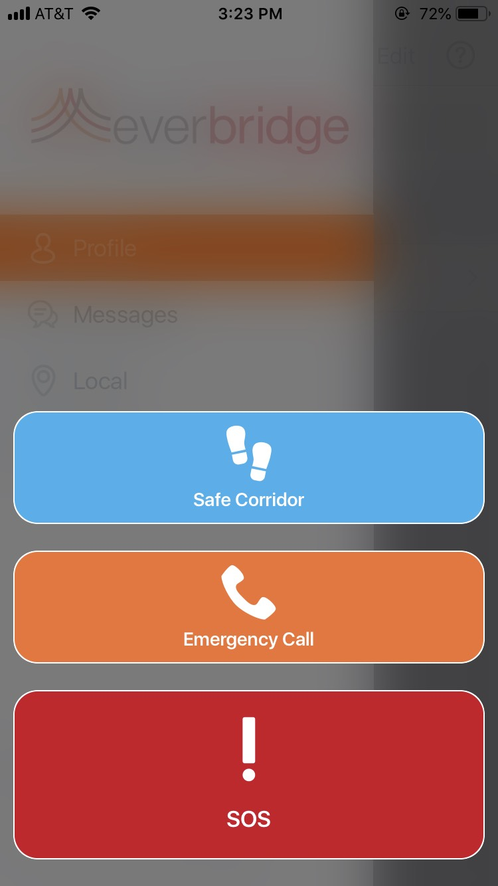
Emergency communications
Emergency Webpage
Mass Notification Communication System - Everbridge
Email
Text
Voicemail
ALERTUS
Blue Light Sirens
Social Media: @TulaneEmergency - Facebook - Twitter - Instagram

Slide 5
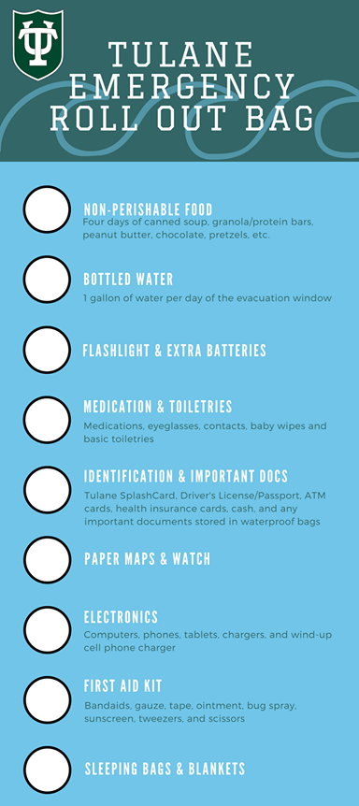
Hurricane Awareness
7 days out we see it, 5 days out we know if its coming to us, and if Tulane is closing you will know 3 days out (if not more)
-Buy your plane tickets early
-Things to keep for emergencies:
-Cash
-Picture IDs
-Emergency Contact information NOT on a cell phone
TIP- Don’t leave behind important documentations or family heirlooms when you evacuate!
If for some reason you can not evacuate, please contact the student affairs department and/or TUPD and they will assist in taking you to University of Alabama in Birmingham (it will not be fun so have a plan!)

Slide 6
Safety Plans
Before you register for classes make sure you fill out your personal safety plan
- Gibson Tulane >Student Evacuation Plan
Also, updating your emergency contacts each year makes sure you will receive emergency messaging
Don’t put your parents phone numbers or home numbers in YOUR contact information - Parents can register elsewhere

Slide 7
RUN, HIDE, FIGHT
RUN
Do not run towards the shooter
Do not wait for anyone or anything
Do not take your belongings with you
HIDE
If you can not run away then hide
Hide under or behind thick objects
Be extremely quiet and still as not to draw attention
Concealment versus Cover
FIGHT
Only as a LAST RESORT
Do this with a group of people
Use whatever heavy object you may have on hand like laptops or chairs
Take the gun/weapon away as soon as possible
Fight like your life depends on it! Because it does!

Slide 8
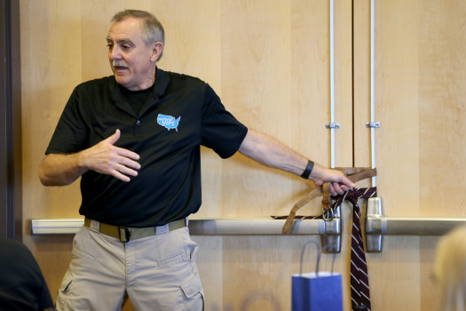
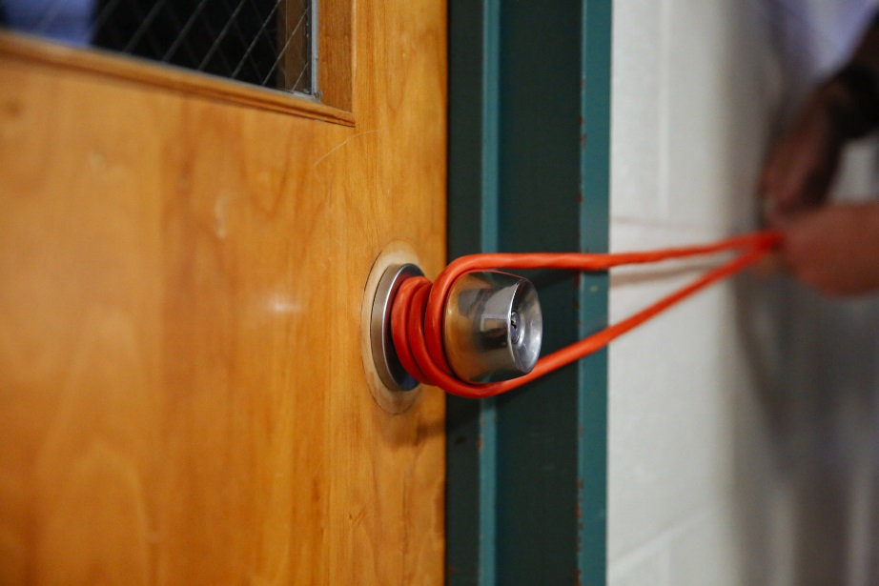
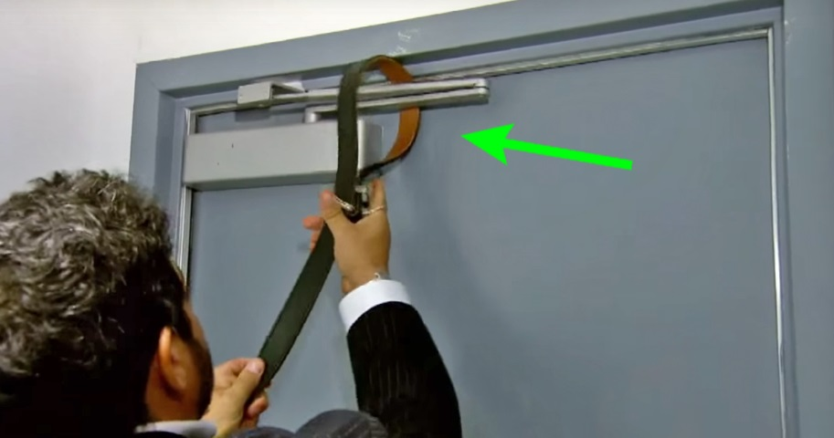
Resources you can use to keep doors shut:
Belt
Shoelaces
Door stop
Power cords
Anything that’s long and can be wrapped around a door

Slide 9
What Students Should Do
Notify Authorities - But ONLY if you can do so safely
Pay attention to Emergency Messages- we will always use clear language - NO CODES will be used!
Do NOT go near the area(s) that may be affected... Seriously DON’T!
Move fellow students and staff to safe areas (but DON’T waste time trying to persuade them)
Lock the door and Stay PUT until All Clear Messages have been sent
-Silence your cell phone and other possible sources of noise
-Hide behind or underneath large items
-Remain quiet
TIP - You can use the Everbridge App and/or respond back to emergency texts to send messages to TUPD and Emergency Personnel directly
RUN, HIDE, FIGHT if needed

Slide 10
Questions?
Phone: 504-862-8266
Social Media: @TulaneEmergency - Facebook - Twitter - Instagram
Website: emergencyprep.Tulane.edu
Email: emergencyprep@Tulane.edu

Slide 11
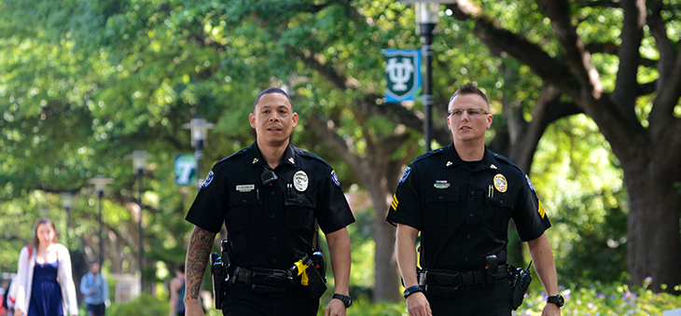
Tulane University Police Department
Lt. Roger Barnes

Slide 12
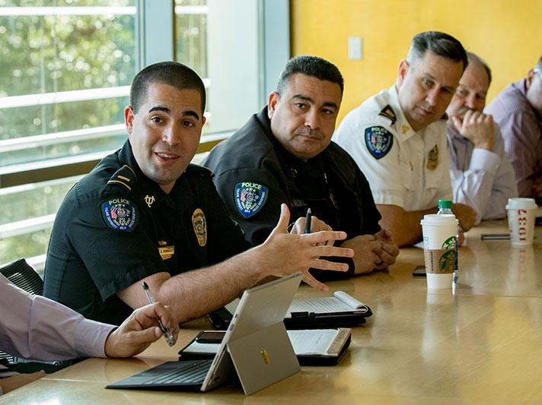
Sworn Police Officers
Fully commissioned police officers
La. P.O.S.T. Academy Graduates
100 Commissioned Police Officers
Black Shirts & Black Pants
Patrol on Foot, Bike, and Motorized Vehicles

Slide 13
TUPD Police Services
Escorts 24 hours a day 365 days a year.
R.A.D. monthly classes (Schedule available online)
Crime Alerts
Vehicle Assists (Jump Starts & Unlocks)
Security Assessments

Slide 14
Crime Prevention
Theft is the most predominate crime on Tulane’s campus
Majority of thefts are preventable!
Unattended property
Bicycle Theft
Secure your bicycles!
Use a U-lock type lock, cable locks are easily defeated
Opportunity is the major cause of ALL crimes
Secure all portable items of value!

Slide 15
Everbridge
What is Everbridge?
Everbridge is a emergency mass notification system and personal safety service that is available free to Tulane students, faculty, and staff who have a Tulane.edu login
Once you register and create a user profile, you may use the Safe Corridor feature while walking or traveling in uncomfortable situations. This feature will prompt you to enter a code at regular intervals throughout your journey to ensure your safety. Upon your safe arrival, simply disarm the feature. If you do not disarm the feature, TUPD will be notified and we will follow up.
Emergency Call & SOS button

Slide 16
Report It-Leads Online
Property inventory system
-Free registration at reportit.leadsonline.com
-Keep a secure, online record of valuable property, accessible from anywhere.
-Include serial numbers and pictures
-If property is ever stolen, Law Enforcement can flag the item in the system and receive a notification if the property is entered into a Louisiana pawn shop

Slide 17
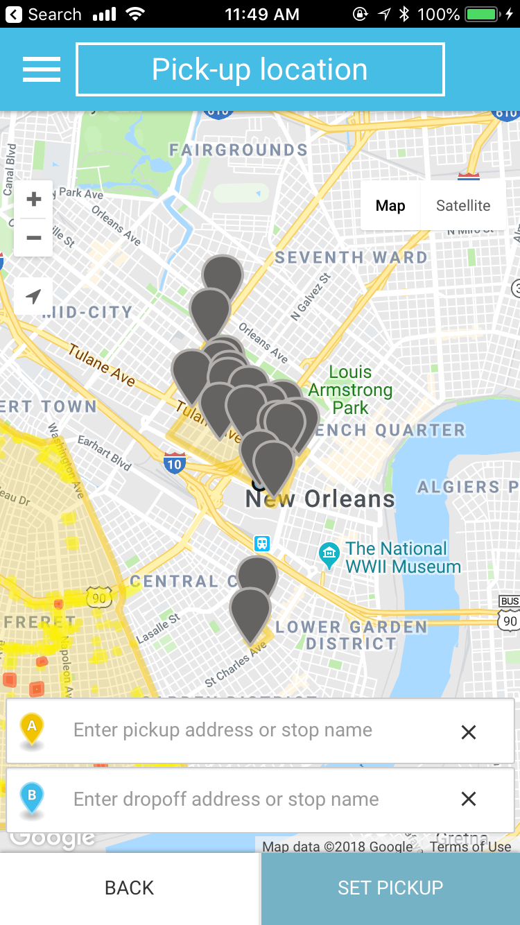
TAP Ride
Tap Ride is a mobile application used by Shuttles and Transportation
Can request a ride via the Gold Zone Shuttle
http://www2.tulane.edu/universityservices/transportation/gold-zone.cfm
Call 504-314-7233
Get the app! Search “TapRide” and select Tulane University!

Slide 18
Contact Us/Questions
EMERGENCY: (504) 865-5911
Non-Emergency: (504) 865-5381
Web Site Address: http://tulane.edu/police
e-Mail address: police@tulane.edu

